Slide 1
Robotic Arm Sorting with Object Detection
Leveraging Vision & AI for Assembly Line Sorting

Slide 2
Introduction
The robotic arm, powered by YOLO, is revolutionizing manufacturing processes by enhancing efficiency and precision. It performs precise sorting tasks, identifying objects based on visual attributes. This system, controlled by a Raspberry Pi Pico, is transforming assembly lines and enhancing the efficiency of manufacturing processes.
To design an automated Robotic Arm Sorting System using YOLO and OpenCV for :
Faster, error-free sorting
Enhanced efficiency in high-volume tasks
Reduced manual intervention
Adaptability for diverse sorting needs
This project showcases how AI and Robotics Transform industrial processes.

Slide 3
Problem Statement
On assembly lines, manual sorting is time-consuming, labour-intensive, and error-prone, which results in inefficiencies in high-volumes.
Challenges
Inconsistency : Errors in human weariness cause variations in sorting quality.
High Labour Cost : Reliance on human labour raises operating costs.
Limited Speed : The speed of contemporary production lines is too fast for human sorting.
Errors in Classification : Subjective judgement may lead to items being incorrectly classified.
Safety Concerns : Employees are subjected to potential risks and repetitious duties.
These issues are resolved by implementing a robotic arm with object detection, which offers scalable, reliable, and secure sorting solutions for manufacturing lines.

Slide 4
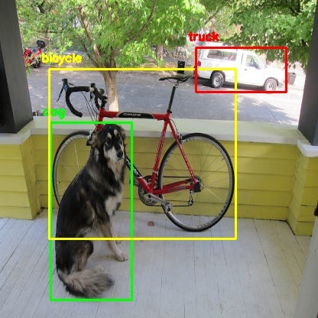
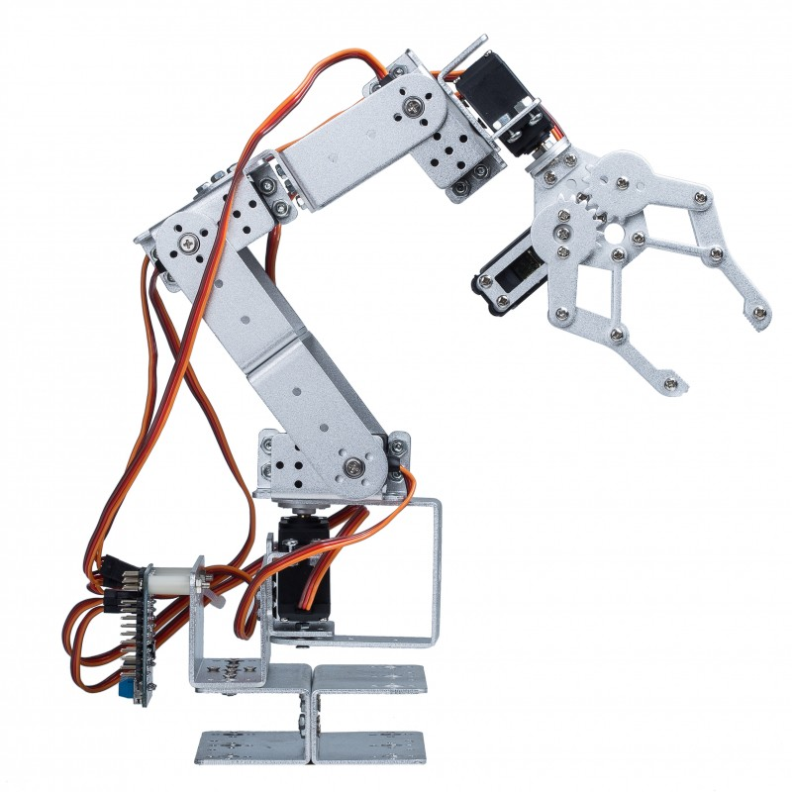
System Overview – Part 1
Object Detection System
Camera : Captures real-time images for analysis.
Algorithm : YOLO for real-time object detection. OpenCV for image preprocessing and feature extraction.
Robotic Arm
Structure : Multi-jointed arm with a gripper for handling objects.
Servo Motors : Control precise arm movement based on microcontroller instructions.

Slide 5
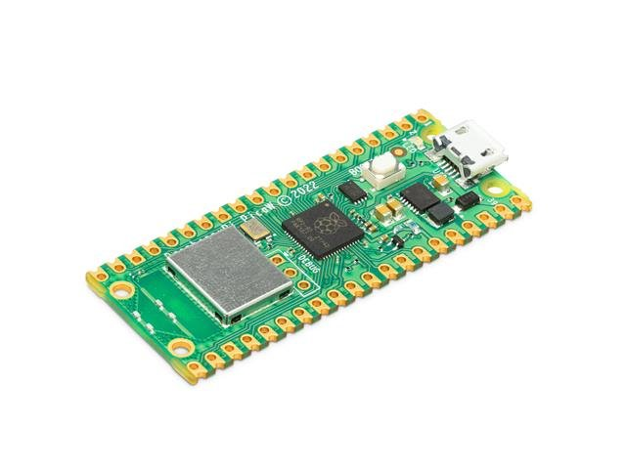
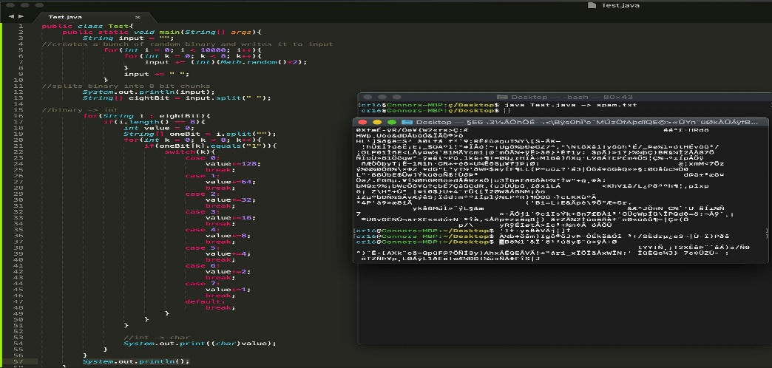
System Overview – Part 2
Microcontroller(Raspberry Pi Pico)
Interprets signals from the object detection system.
Controls servo motors for arm movements using MicroPython.
Sorting Logic
Predefined rules for sorting based on object characteristics(colour, shape).
Feedback mechanism logs unrecognized objects for manual review.
Workflow
Camera detects and classifies objects.
Microcontroller receives object data and moves the robotic arm.
Robotic arm picks, sorts, and resets for the next cycle.

Slide 6
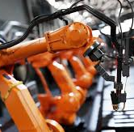
Real-World Implementation
Use Case 1 : Sorting by colour for plastic recycling plants.
Use Case 2 : Size-based sorting in the packaging industry.
Use Case 3 : Shape recognition in electronic manufacturing.
Use Case 4 : Quality Control and Defect Sorting in Automotive industry.
Use Case 5 : Food sorting in agriculture and food processing.
Use Case 6 : Material Identification in construction material sorting.

Slide 7
Benefits of the System
Enhanced Efficiency : Automates repetitive tasks, reducing processing time and increasing throughput. Operates continuously without fatigue, ensuring consistent output.
Improved Accuracy : Detects and sorts objects with precision, minimising human error. Ensures consistent quality across all sorting operations.
Cost Savings : Reduces reliance on manual labour, lowering operational costs over time. Minimal maintenance costs compared to long-term labour expenses.
Scalability : Easily adaptable to different assembly line tasks and production scales.
Workspace Safety : Eliminates the need for humans to perform hazardous, repetitive tasks.

Slide 8


Challenges and Future Improvements
Challenges
Initial Setup Costs
Detection Limitations
Maintenance Requirements
Algorithm Limitations
Adaptability Issues
Future Improvements
Advanced Object Detection
Improved Hardware
Feedback and Learning Systems
Modular Design
Energy Efficiency

Slide 9
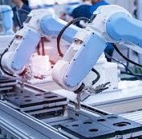
Conclusion
The robotic arm revolutionizes assembly line automation by improving scalability, accuracy, and efficiency. It reduces human error and operating expenses, enhancing worker safety. Future AI advancements offer opportunities for further optimization, despite initial setup costs and detection restrictions.

Slide 10
Q&A

